Slide 1
COMPILER DESIGN LAB

Slide 2
PROGRAM 1
Implementing a Deterministic Finite Automata (DFA) for a given language.

Slide 3
Deterministic Finite Automata (DFA)
In DFA, for each input symbol, one can determine the state to which the machine will move.
Hence, it is called Deterministic Automaton.
As it has a finite number of states, the machine is called Deterministic Finite Machine or Deterministic Finite Automaton.

Slide 4
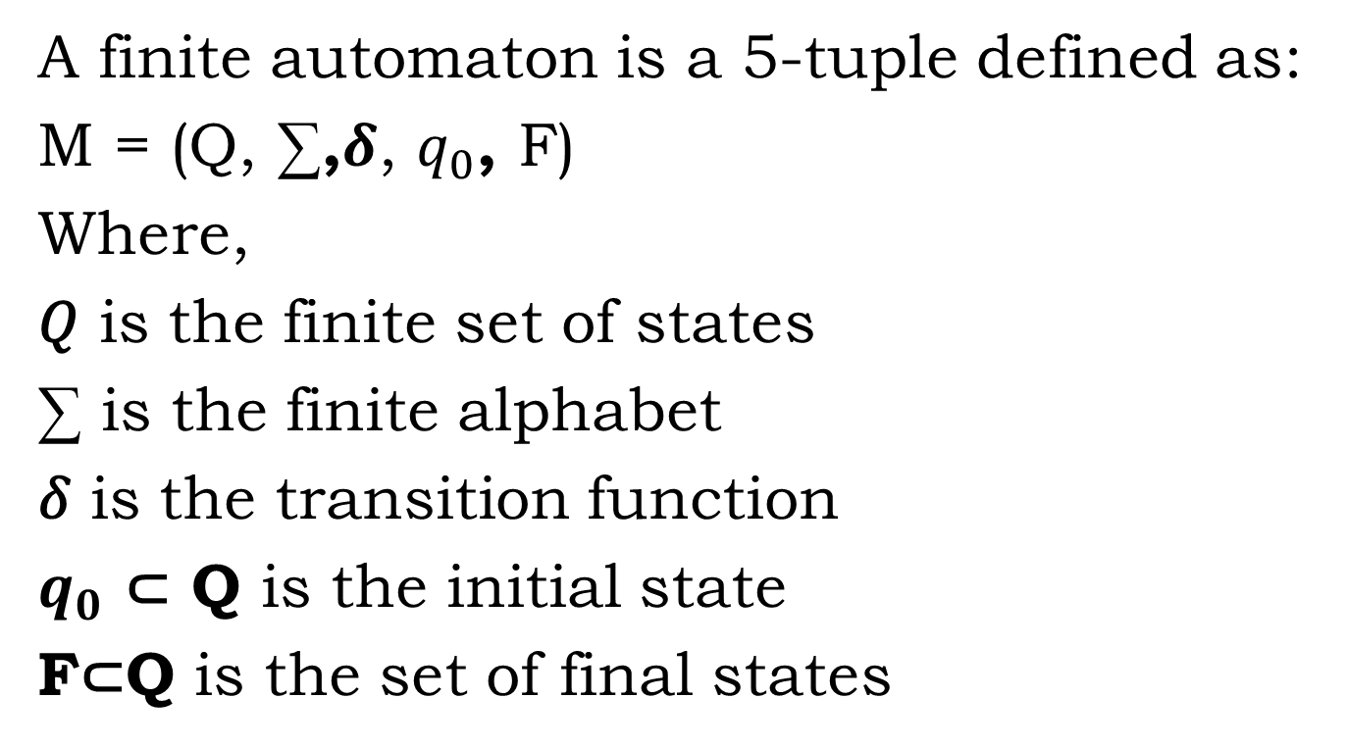
Deterministic Finite Automata (DFA)
A finite automaton is a 5-tuple defined as:
M = (Q, ∑,𝜹, $q_{0}$, F)
Where,
𝑄 is the finite set of states
∑ is the finite alphabet
𝛿 is the transition function
$q_{0}$ ⊂ Q is the initial state
F⊂Q is the set of final states

Slide 5
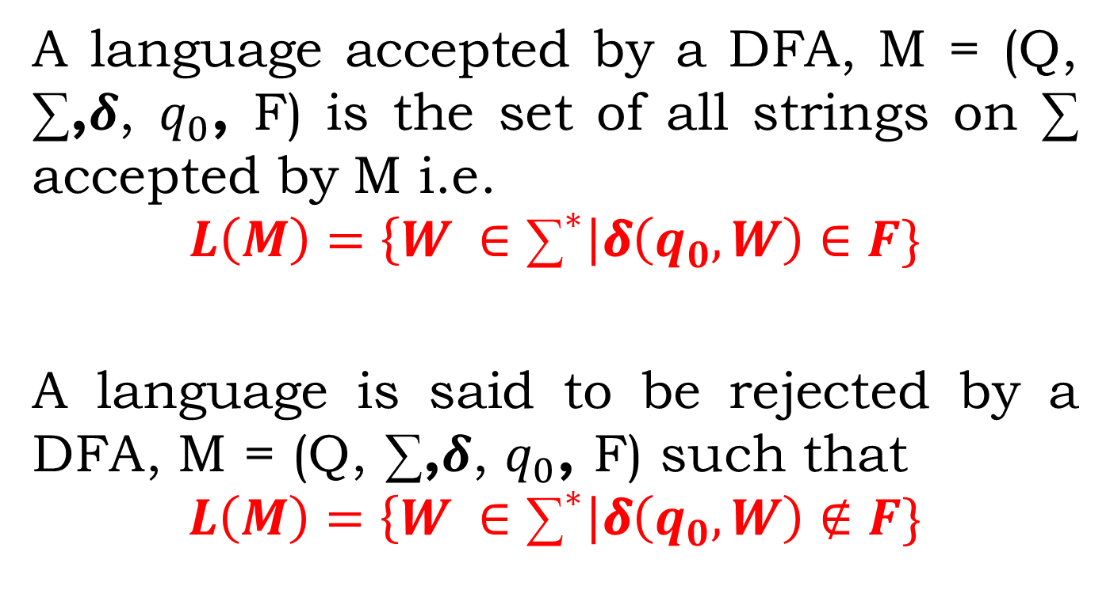
Language Acceptance
A language accepted by a DFA, M = (Q, ∑,𝜹, $q_{0}$, F) is the set of all strings on ∑ accepted by M i.e.
$$L\left(M\right)=\left\{W ∈{\text{∑}}^{∗}\right|\text{δ}\left(q_{0},W\right)∈F\}$$
A language is said to be rejected by a DFA, M = (Q, ∑,𝜹, $q_{0}$, F) such that
$$L\left(M\right)=\left\{W ∈{\text{∑}}^{∗}\right|\text{δ}\left(q_{0},W\right)∉F\}$$

Slide 6
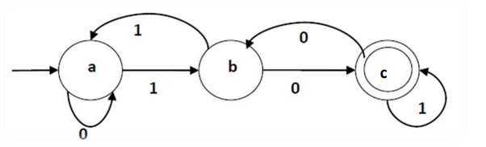
EXAMPLE
A
B
C
Transition Diagram
Here , Q = {A,B,C},
∑ = {0, 1},
q0 = A,
F = {C}

Slide 7
EXAMPLE
A
B
C
Here , Q = {A,B,C},
∑ = {0, 1},
q0 = A,
F = {C}
Transition Table
𝜹 | 0 | 1
A | A | B
B | C | A
C | B | C

Slide 8
Implementation of Deterministic Finite Automata (DFA)
Aim: To check whether a string is accepted by the DFA or not.
Algorithm:
Step1: Create a 2D table for Transition Table (T).
Step1.1: Declare state as one dimension.
Step1.2: Declare Input symbol as one dimension.
Step2: For every transition State_{i} ª State_{j} define
T[i,a] =j.
Spep3: Declare 1 dimensional array for input string named as input.
Step4:Specify the initial state and final states.
Step5: Scan every input symbol from the input and check the state from the transition table T.

Slide 9
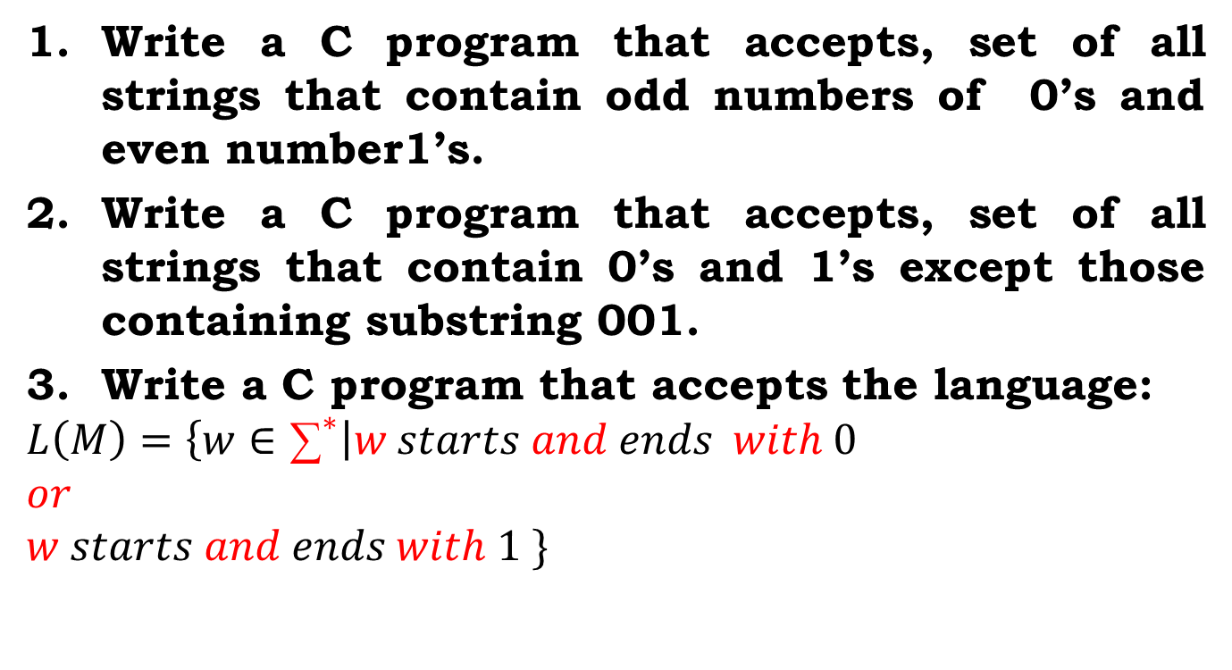
Assignment:
Write a C program that accepts, set of all strings that contain odd numbers of 0’s and even number1’s.
Write a C program that accepts, set of all strings that contain 0’s and 1’s except those containing substring 001.
Write a C program that accepts the language:
$$L\left(M\right)=\left\{w∈{\text{∑}}^{∗}\right|w starts and ends with 0$$
$$or$$
$$w starts and ends with 1 \}$$

Slide 10
Instructions
****Draw the DFA transition diagram in your note copy.
Input:
String to check the acceptance
Output:
1. Transition Table in 2D array
Ex. T[currentstate, inputsymbol]=new state
2. String accepted
String rejected
3. Sequence of the input transition

Slide 11
Instructions
SL. No | Roll Numbers | Question
1 | 1-20 | 1
2 | 21-40 | 2
3 | 41-rest | 3

